Slide 1
ToastBusters
One Stop Application to Manage your Pantry for a Scrumptious Meal
Rishab Agarwal (002766211) Shobhit Srivastava(002965382) Taru Shukla(002193864)

Slide 2
Introduction
Why Grocery Planning Matters?
In today's busy world, many individuals struggle to maintain a balanced diet and find it challenging
Time constraints and lack of grocery planning expertise
Individuals with specific dietary needs or restrictions face additional challenges in finding suitable recipes.

Slide 3
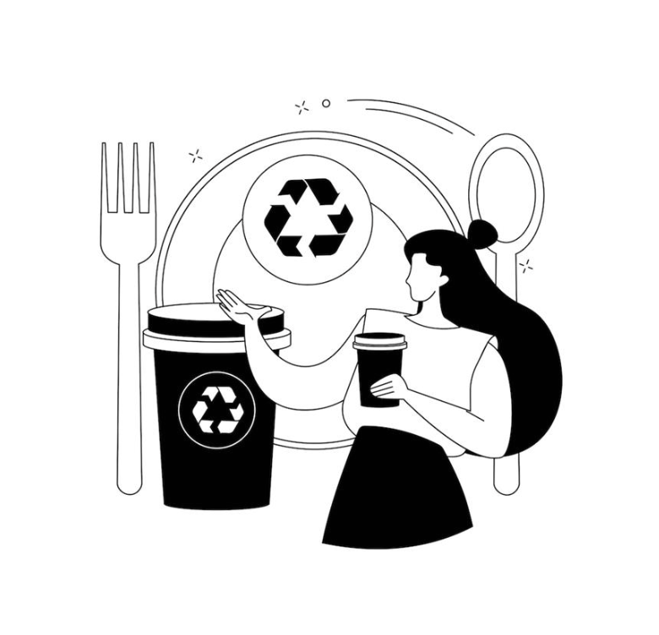
Problem Statement
Struggling with meal ideas with available ingredients
Tedious to search for recipes from multiple sources
Buying groceries for desired dishes can be inconvenient and time consuming
Wasted time, effort, and food, as ingredients often go unused or expire before consumption
Face Issue to find the exact recipe video and instructions

Slide 4
How Does ToastBusters Solve this Problem??
"Personalized Pantry": A comprehensive solution that helps users make the most of their pantry ingredients to save time, money, and reduce food waste.
"What's in Your Kitchen?" : A recipe suggestion tool designed to help users discover delicious recipes based on the ingredients they already have at home.
"Recipe Favorites” : a user-friendly application designed to help users discover, save, and organize their favorite recipes from a wide variety of sources.

Slide 5
Our Tech Stack
Dev Tools
Project Tools
Tech Used
Core Concepts
Trello
Microsoft Teams
Github
Java
JavaFX
MySQL
Eclipse
Scene Builder
SQL Workbench
Classes and Objects
Inheritance
Interface
Lists
Collections/Iterators
Set

Slide 6
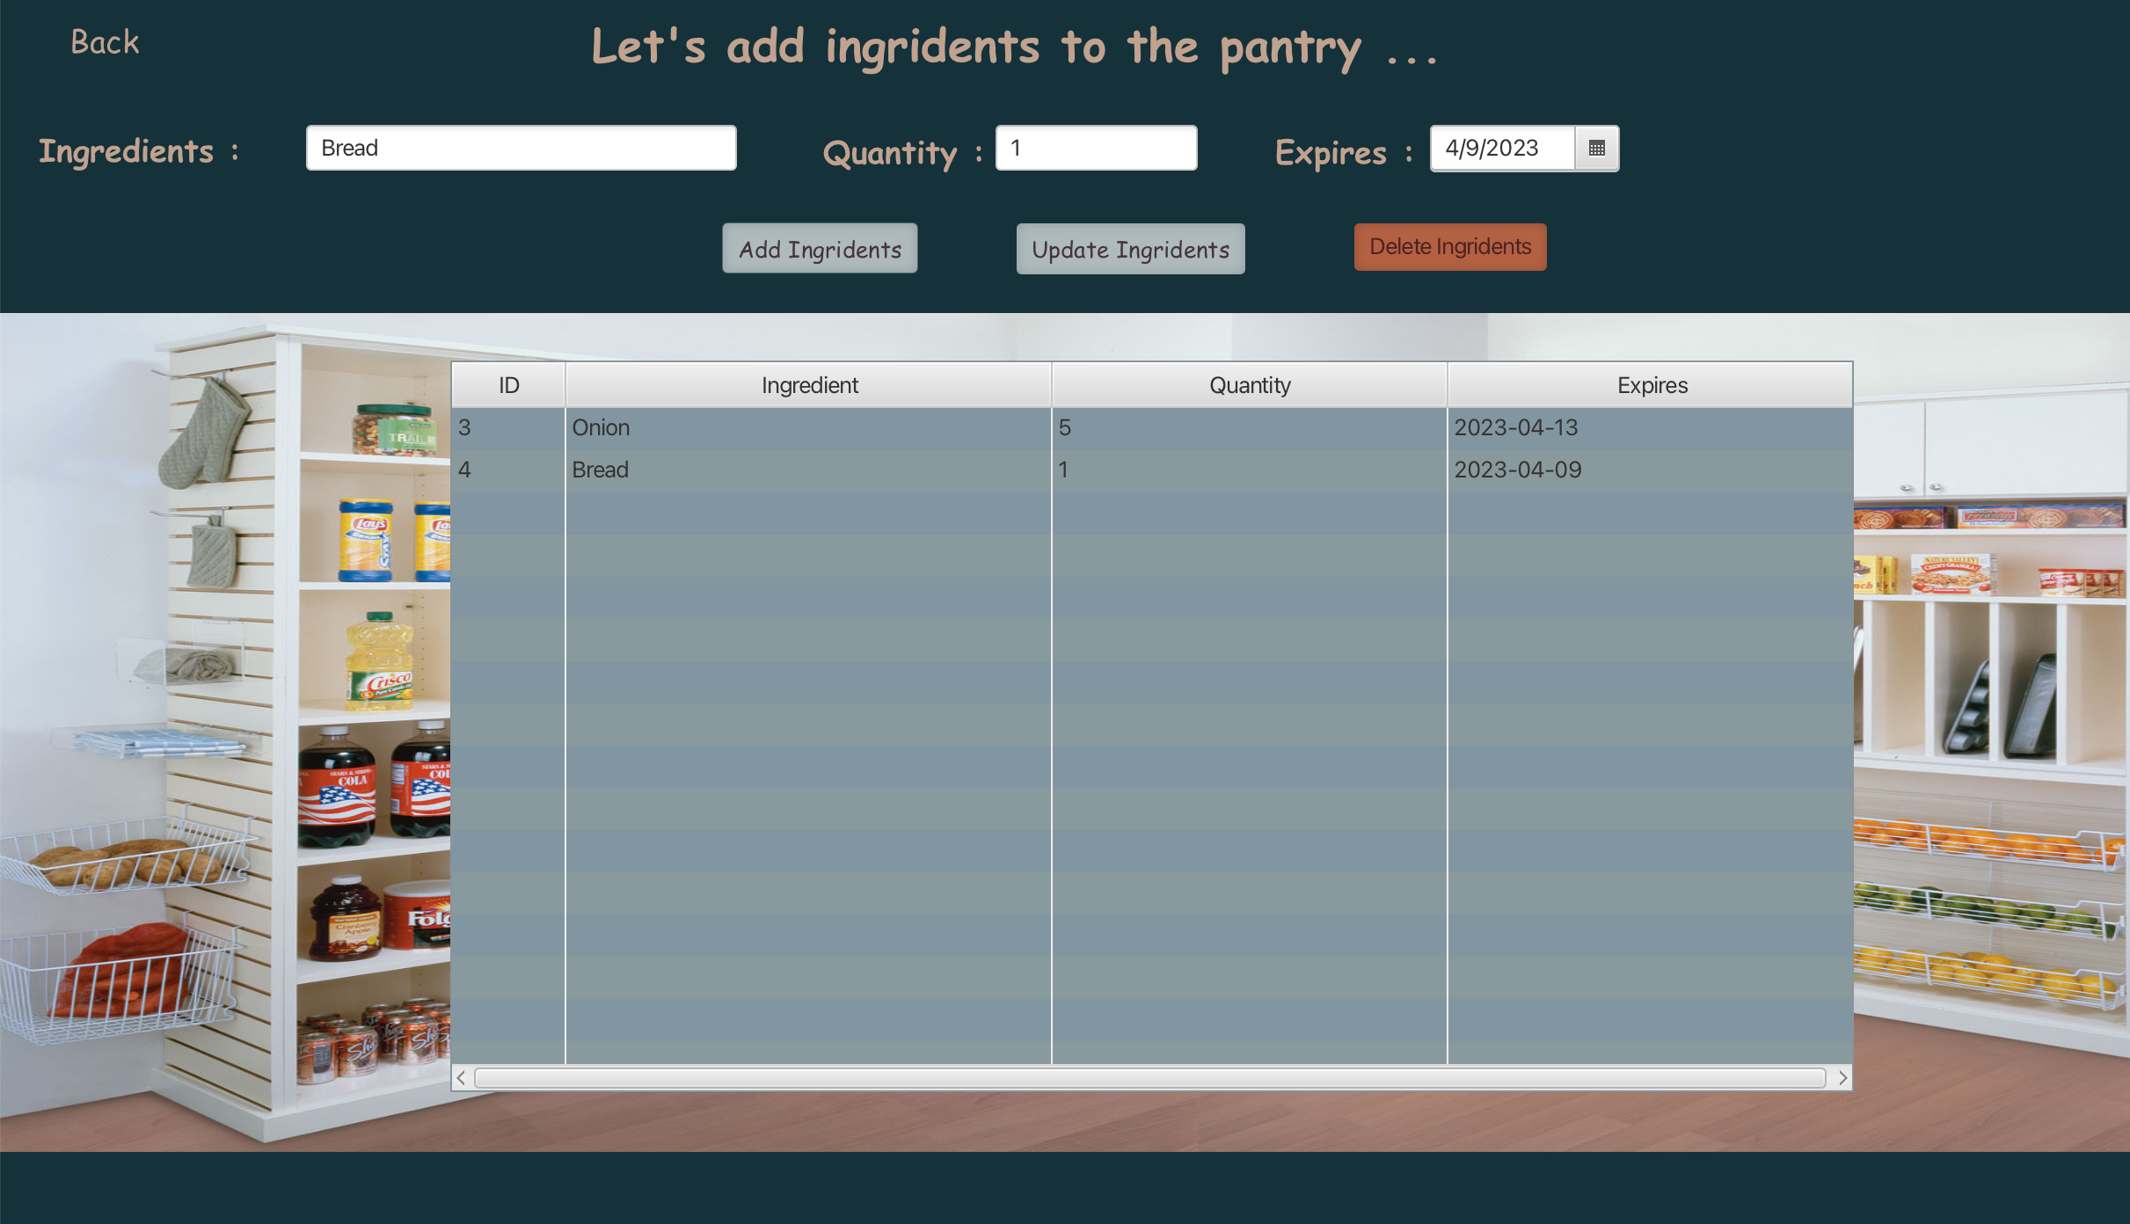
Features (Pantry)
Easily add, edit, and remove pantry items
Set quantity, expiration dates

Slide 7
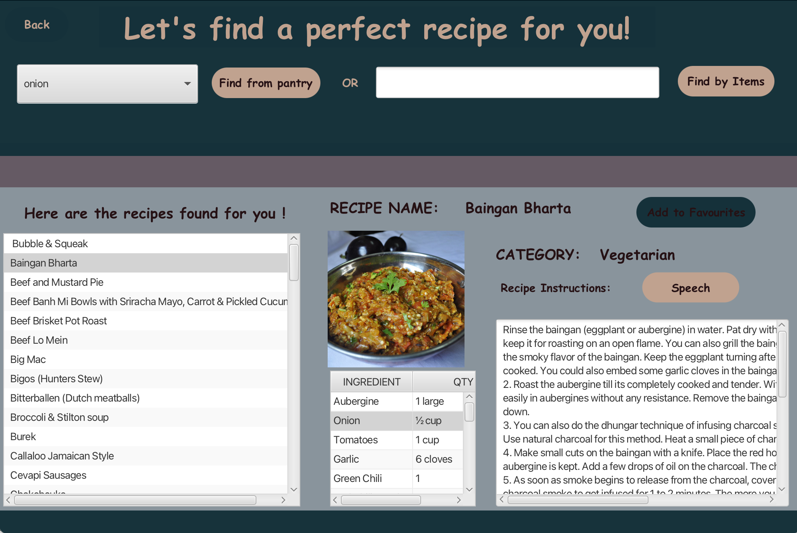
Features Cont.. (Recipe Suggestions)
Finder
Find recipe suggestions based on items in pantry
Search recipes if you are lazy to manage the pantry
Recipe
Select the recipe and check the other ingredients too
Instructions
Get the instructions both in text and audio

Slide 8
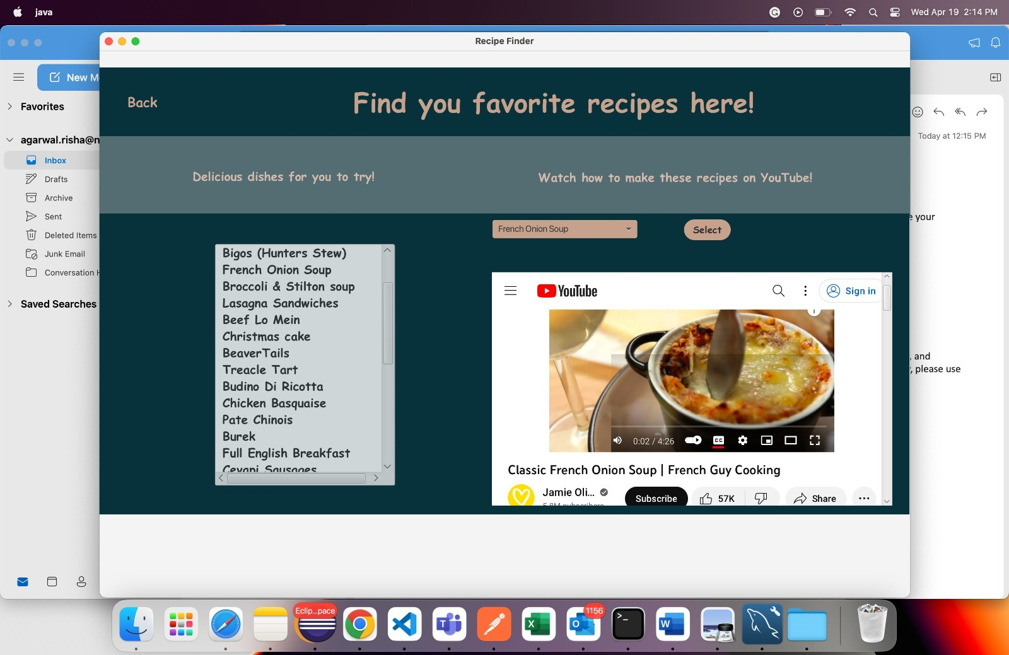
Features Cont.. (Favorites)
View your Favorites
Find your Favorites here
Watch the recipe
Tough to follow the text?? No problem we have video recipes for you !!

Slide 9
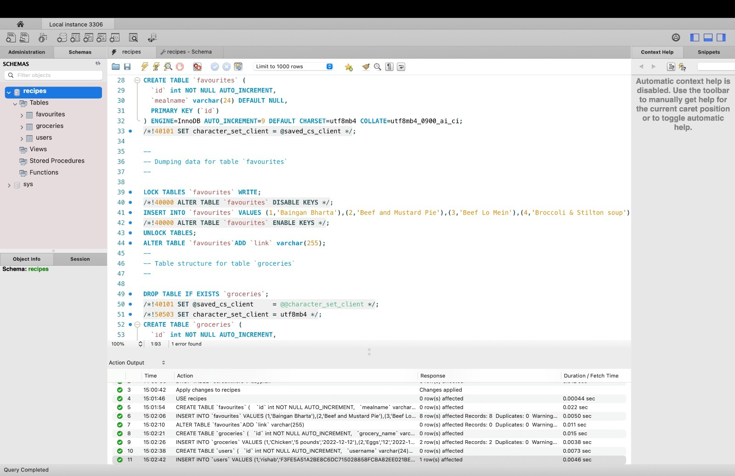
Databases (MySql Workbench)

Slide 10
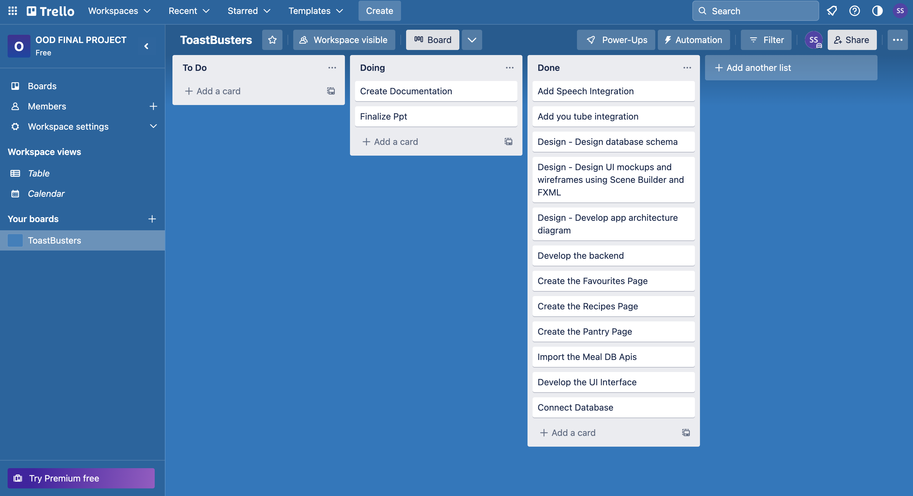
Project Collaboration (Trello)

Slide 11
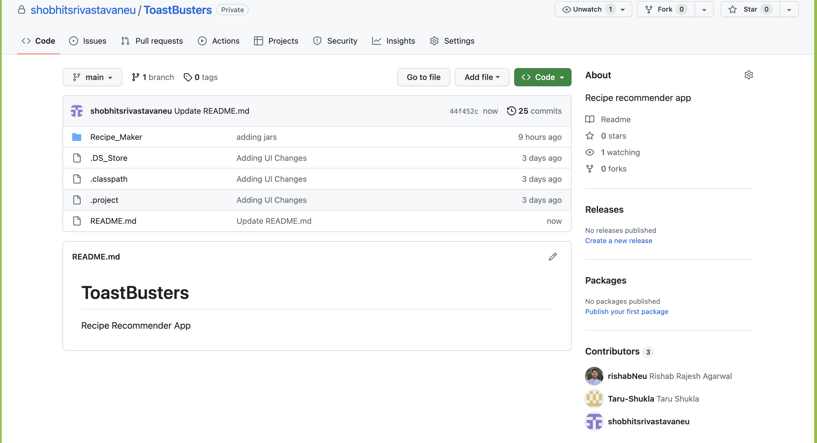
Versioning Tools (Github)

Slide 12
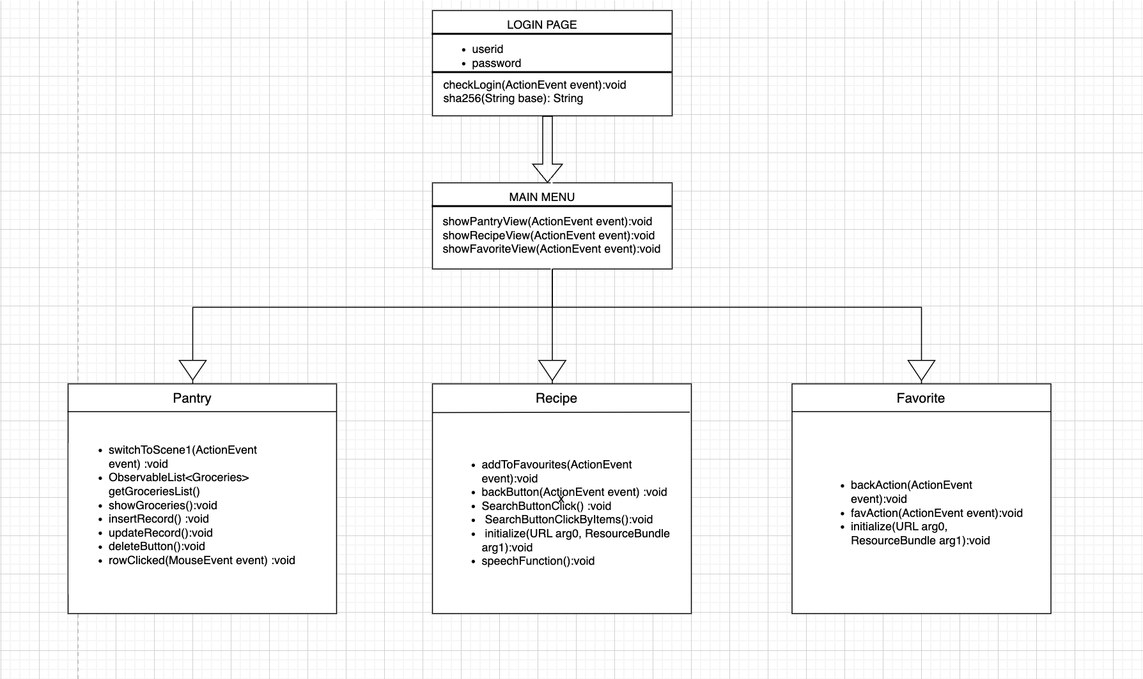
UML Diagram

Slide 13

Difficulties Encountered
It was difficult to grasp and implement the use of abstract classes and interfaces
Designing the user interface with JavaFX was complicated
Integrating speech with text instructions
Mapping the action listeners with component coupled ids which caused few errors

Slide 14
Learnings
User Interface Design and Development:
Understanding the use of SceneBuilder, FXML, JavaFX, and CSS to create custom UI components and styles
Backend Development and Integration
Integrating frontend components with backend services, fostering better collaboration between different layers of the application
Agile Project Management
Breaking down the project into smaller tasks and maintaining a backlog using Trello for better task management and tracking
Collaboration and Version Control:
Using Git and GitHub for efficient version control and collaboration among team members

Slide 15
Future Scope
Order Groceries
Order your groceries from your pantry
Get Notification on Expiry
Get Notifications when the items are near to expiry
Nutrition Count
Dietary recommendations based on user preferences, restrictions, or health goals

Slide 16
Team Contributions
Rishab
Taru
Shobhit
Design and Developed Recipe Screen
Text to Speech integration
Meal Api Integration
Sql Integrations for Recipe Screen
Design and Developed Pantry, Menu Favorite Screen and
CRUD operations
Sql Integrations for Pantry and Favorite Screen
Design and Developed Login Screen
SHA 256 based password hashing
Integrated you tube video for recipes
Sql Integrations for Login Screen

Slide 17
THANK YOU
Lunch
Breakfast
Dinner

